Slide 1

Data-Efficient Strategies for Object Detection
IbPRIA 2025
Dinis Costa & Joana Costa
June 30

Slide 2
Tutorial Goals
Train an Object Detection model on custom data
01
Use Active Learning to reduce annotation workload
02
Understand how annotation quality affects model performance
03
Apply Transfer Learning to boost performance and reduce training time
04
Notes:
Justificar que é um tutorial mais pratico

Slide 3
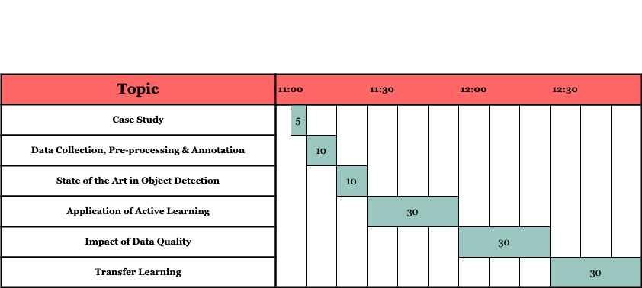
Agenda

Slide 4
Agenda
Case Study
Data collection and Annotation
State of the Art in Object Detection
Application of Active Learning
Impact of Data Quality
Transfer Learning

Slide 5
Case Study Motivation
Pests destroy up to 40% of crops globally
Traditional pest control is costly, chemical-heavy, and often reactive
Feeding the world sustainably requires smarter farming : more precise and proactive
Early detection can save billions and reduce pesticide use, which means healthier crops, safer food, and a greener plane
Data-driven farming is the future

Slide 6
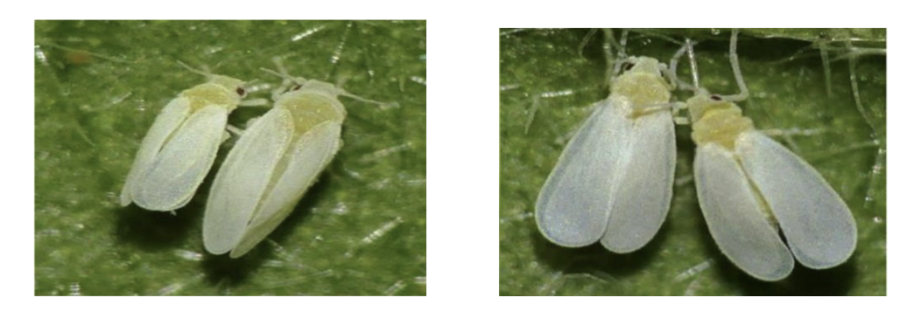
Case Study The whitefly pest
Whiteflies are small, sap-sucking insects that pose a significant threat to agriculture worldwide
Feed on plant sap, weakening crops and reducing yields
Reproduce rapidly
Vectors of many plant viruses
Spread worldwide and affect a multiple range of crops — including cotton, tomato, soybean and cassava
One the most significant agricultural pests globally
Lead to billions of dollars in economic losses annually

Slide 7
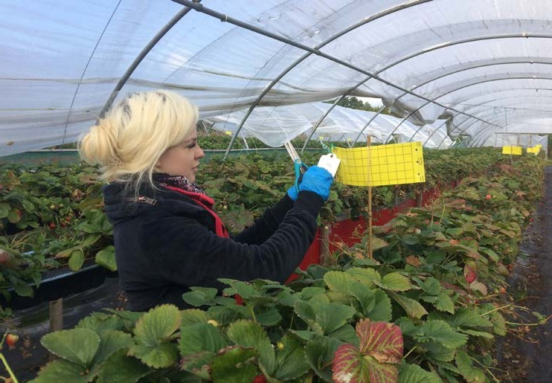
Case Study Conventional methods
Conventional methods include:
Yellow sticky traps to monitor populations, manually checked
Manual removal of heavily infested leaves in small-scale farming.
Time consuming as it is totally human-based
Heavy reliance on insecticides that leads to resistance development
Costly

Slide 8
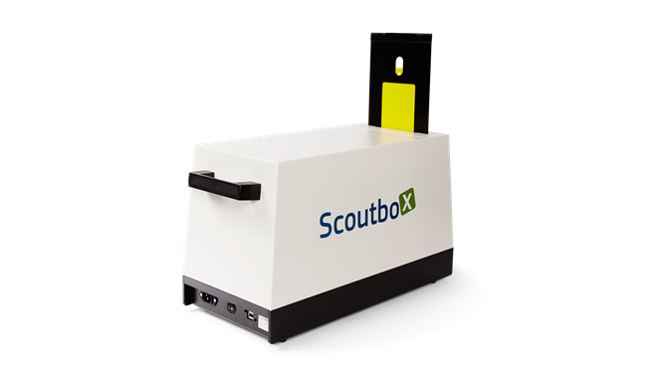
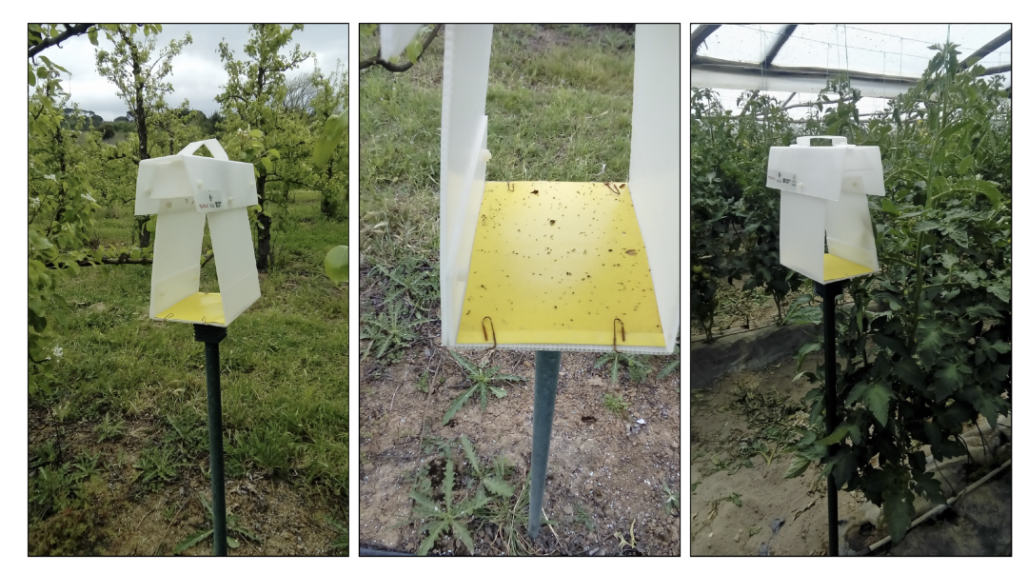
Case Study Smart farming methods
Scoutboxes combine sticky traps with IoT sensors, cameras, and connectivity.
Capture images of trapped insects automatically
Can use onboard or cloud-based to identify, count, and report pest populations in real-time
Benefits include:
Early detection: enabling rapid intervention before outbreaks spread.
Reduced labor: eliminating manual scouting rounds.
Data-driven decisions: providing precise pest population trends over time.
Sustainability: allowing targeted treatment and reducing unnecessary pesticide use.

Slide 9
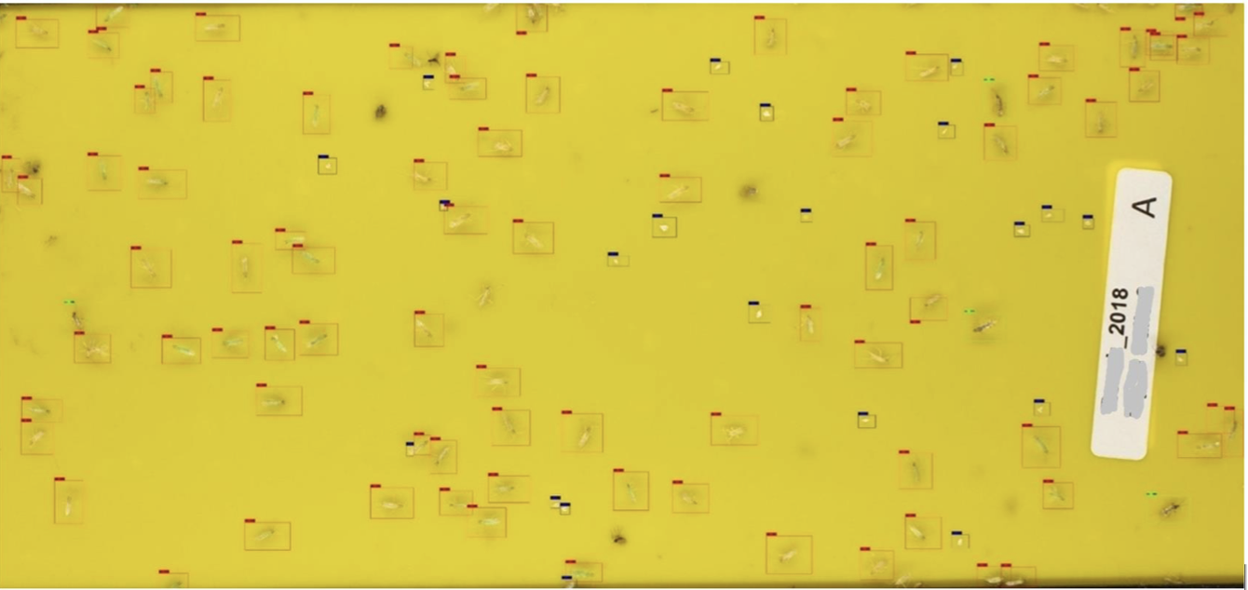
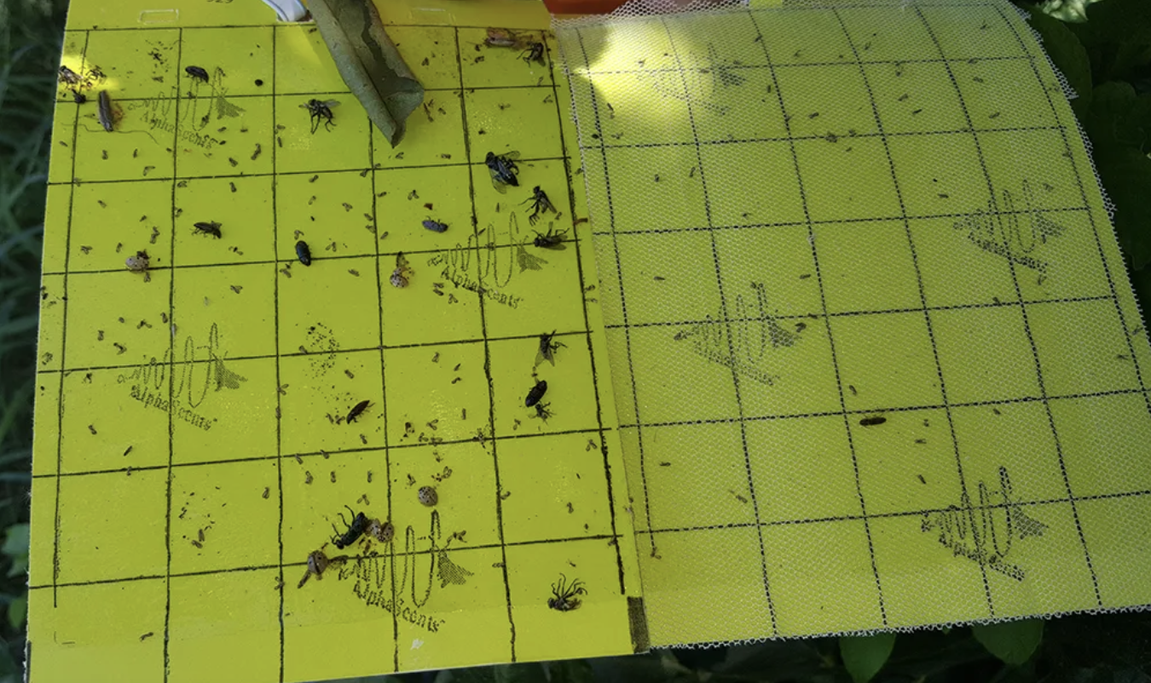
Case Study Challenges
Species identification:
differentiating similar insect species remains difficult
insects captured in traps are usually degraded
Object Detection with few high-quality annotated data
Image quality & environmental conditions: dust, rain, humidity, or sunlight glare
Noisy environment
Cost & scalability: Initial investment and maintenance costs can be high, especially for small-scale farmers.
Low-cost equipment
Object Detection with few high-quality annotated data in noisy environment with low-cost equipment

Slide 10
Case Study Goal
Pest detection
Whitefly Pest
Detections in Natural Environments
Goal is to detect and count whiteflies in an image

Slide 11
Case Study

Slide 12
Case Study

Slide 13
Case Study
Pest detection - importance

Slide 14
Data Collection and Annotation Goal
Diversity is Critical
Represent the real-world
Balance the dataset

Slide 15
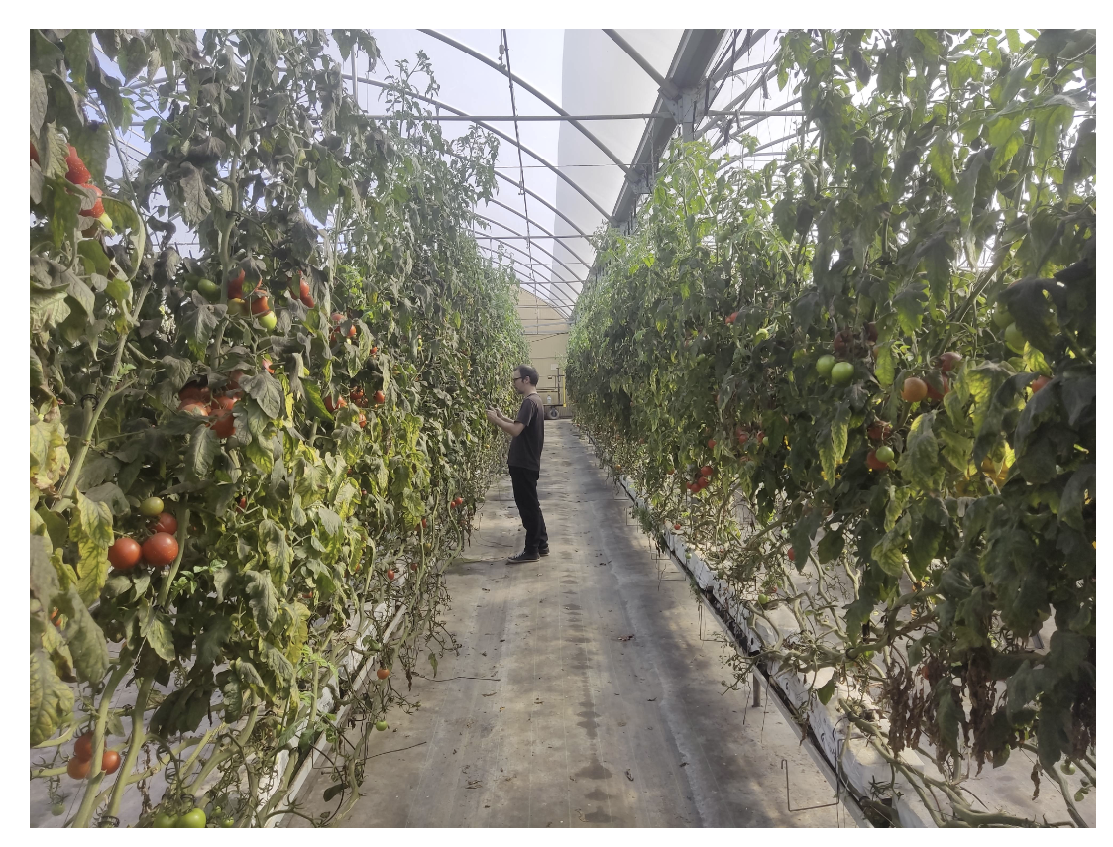
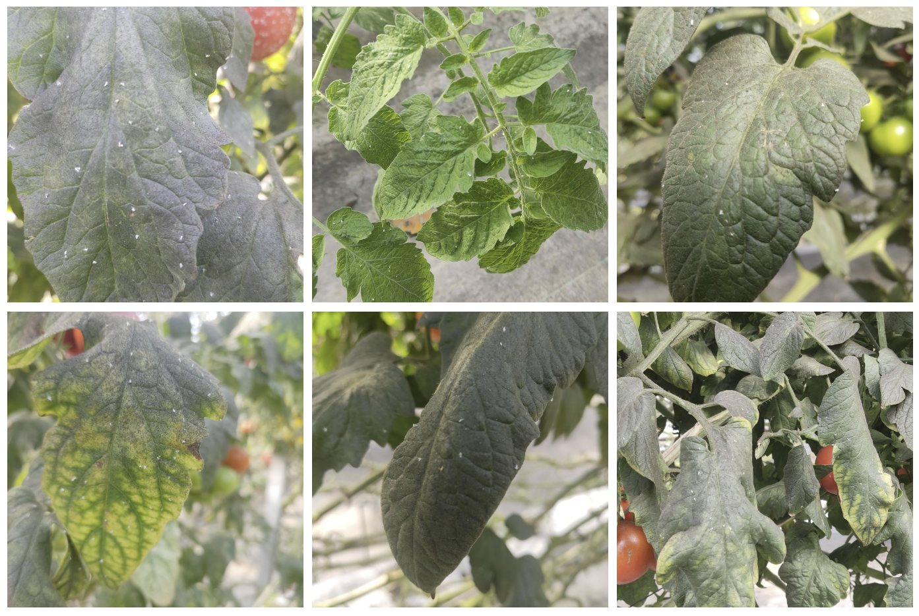
Data Collection

Slide 16
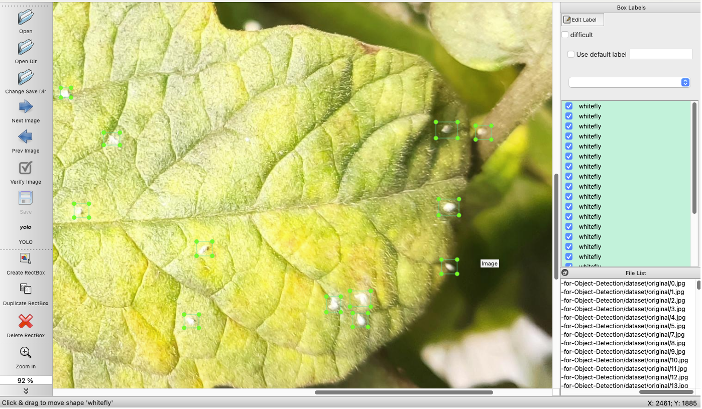
Annotation Goal
The center of the bounding box should align with the center of the corresponding object.
The edges of the bounding box should not exceed the boundaries of the object.
Boxes should be tight but not overly precise — enough to capture the object clearly without including background noise.

Slide 17

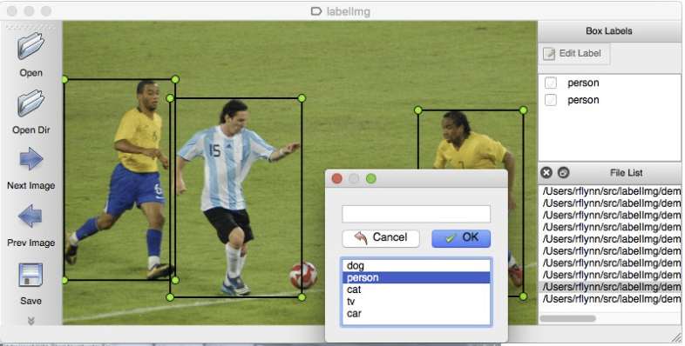
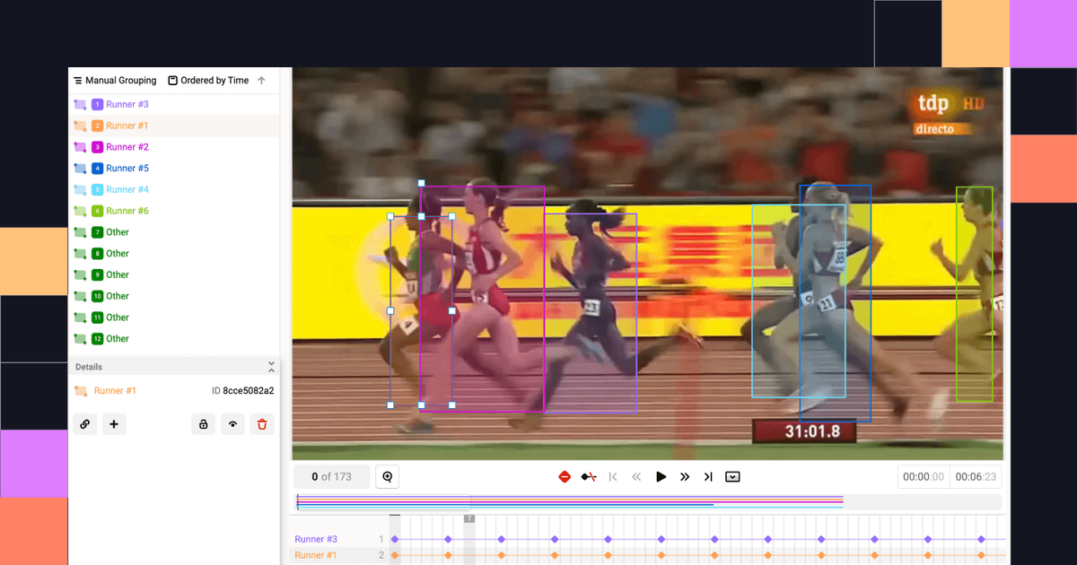
Annotation Tools
LabelImg

Slide 18
Annotation
📂 dataset/
├── image_1.jpg
├── image_1.txt
├── image_2.jpg
├── image_2.txt
├── image_3.jpg
├── image_3.txt
└── ...
[class_id] [center_x] [center_y] [width] [height]
0 0.512 0.634 0.120 0.200 # object of class 0
1 0.278 0.401 0.150 0.180 # object of class 1

Slide 19
Annotation

Slide 20
State-of-the-Art in Object Detection

Slide 21
State-of-the-Art in Object Detection One Stage vs Two Stage Model
1-Stage Detectors
Use Cases:
Real-time applications (e.g., drones, robotics, video surveillance)
Edge devices (e.g., Jetson Nano, Raspberry Pi)
Scenarios where speed is more critical than slight accuracy gains
Examples:
YOLO (v1 → v11)
SSD (Single Shot Multibox Detector)
DETR (transformer-based, one-stage-style)
2-Stage Detectors
Use Cases:
High-accuracy applications (e.g., medical imaging, autonomous vehicles)
Offline processing (speed not critical)
Complex scenes with small or overlapping objects
Examples:
RCNN
Fast RCNN
Faster RCNN

Slide 22
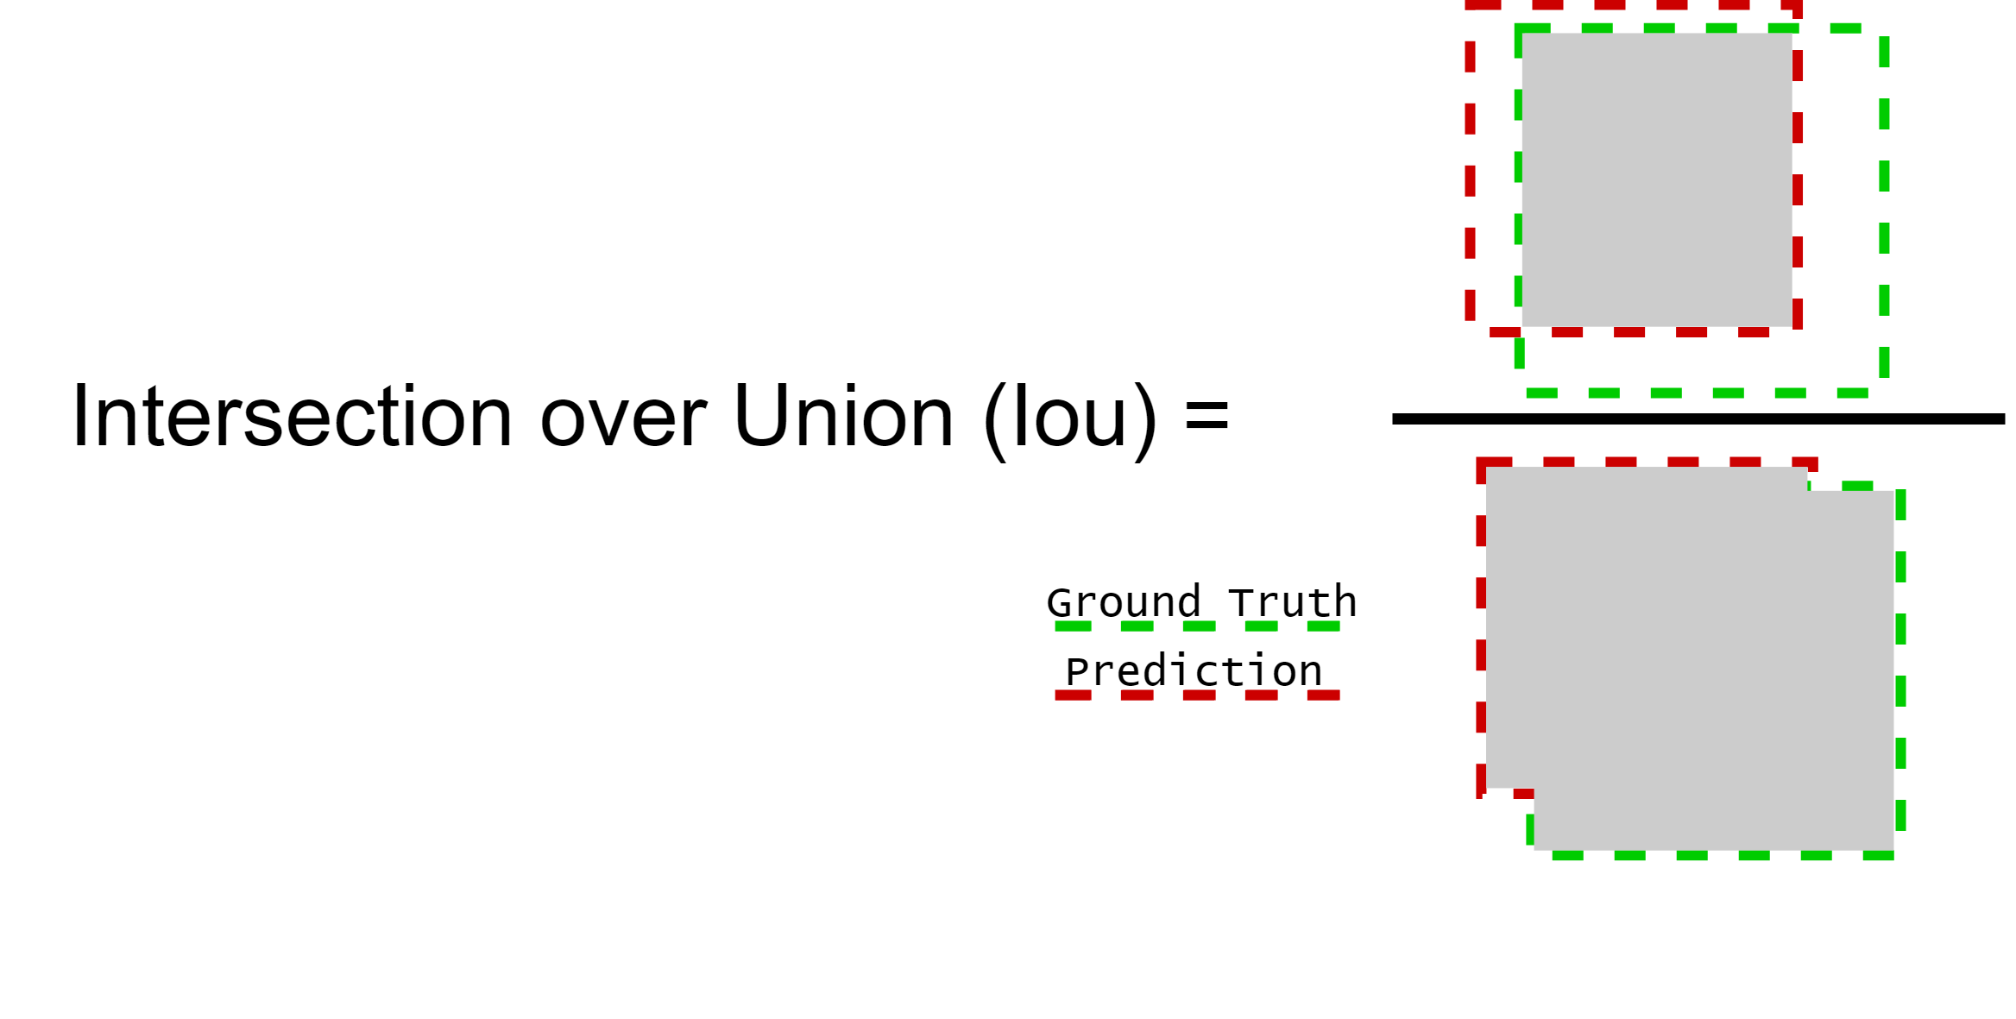
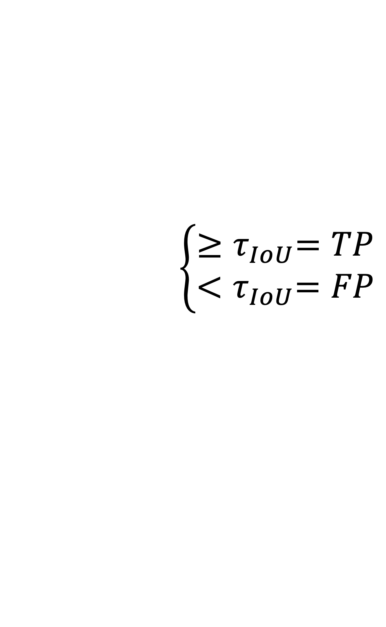
State-of-the-Art in Object Detection Metrics
$$\left\{\begin{aligned}{≥τ}_{IoU}=TP \\ {<τ}_{IoU}=FP\end{aligned}\right.$$

Slide 23


State-of-the-Art in Object Detection Metrics
Precision $= \frac{TP}{TP+FP}$
Recall $= \frac{TP}{TP+FN}$

Slide 24
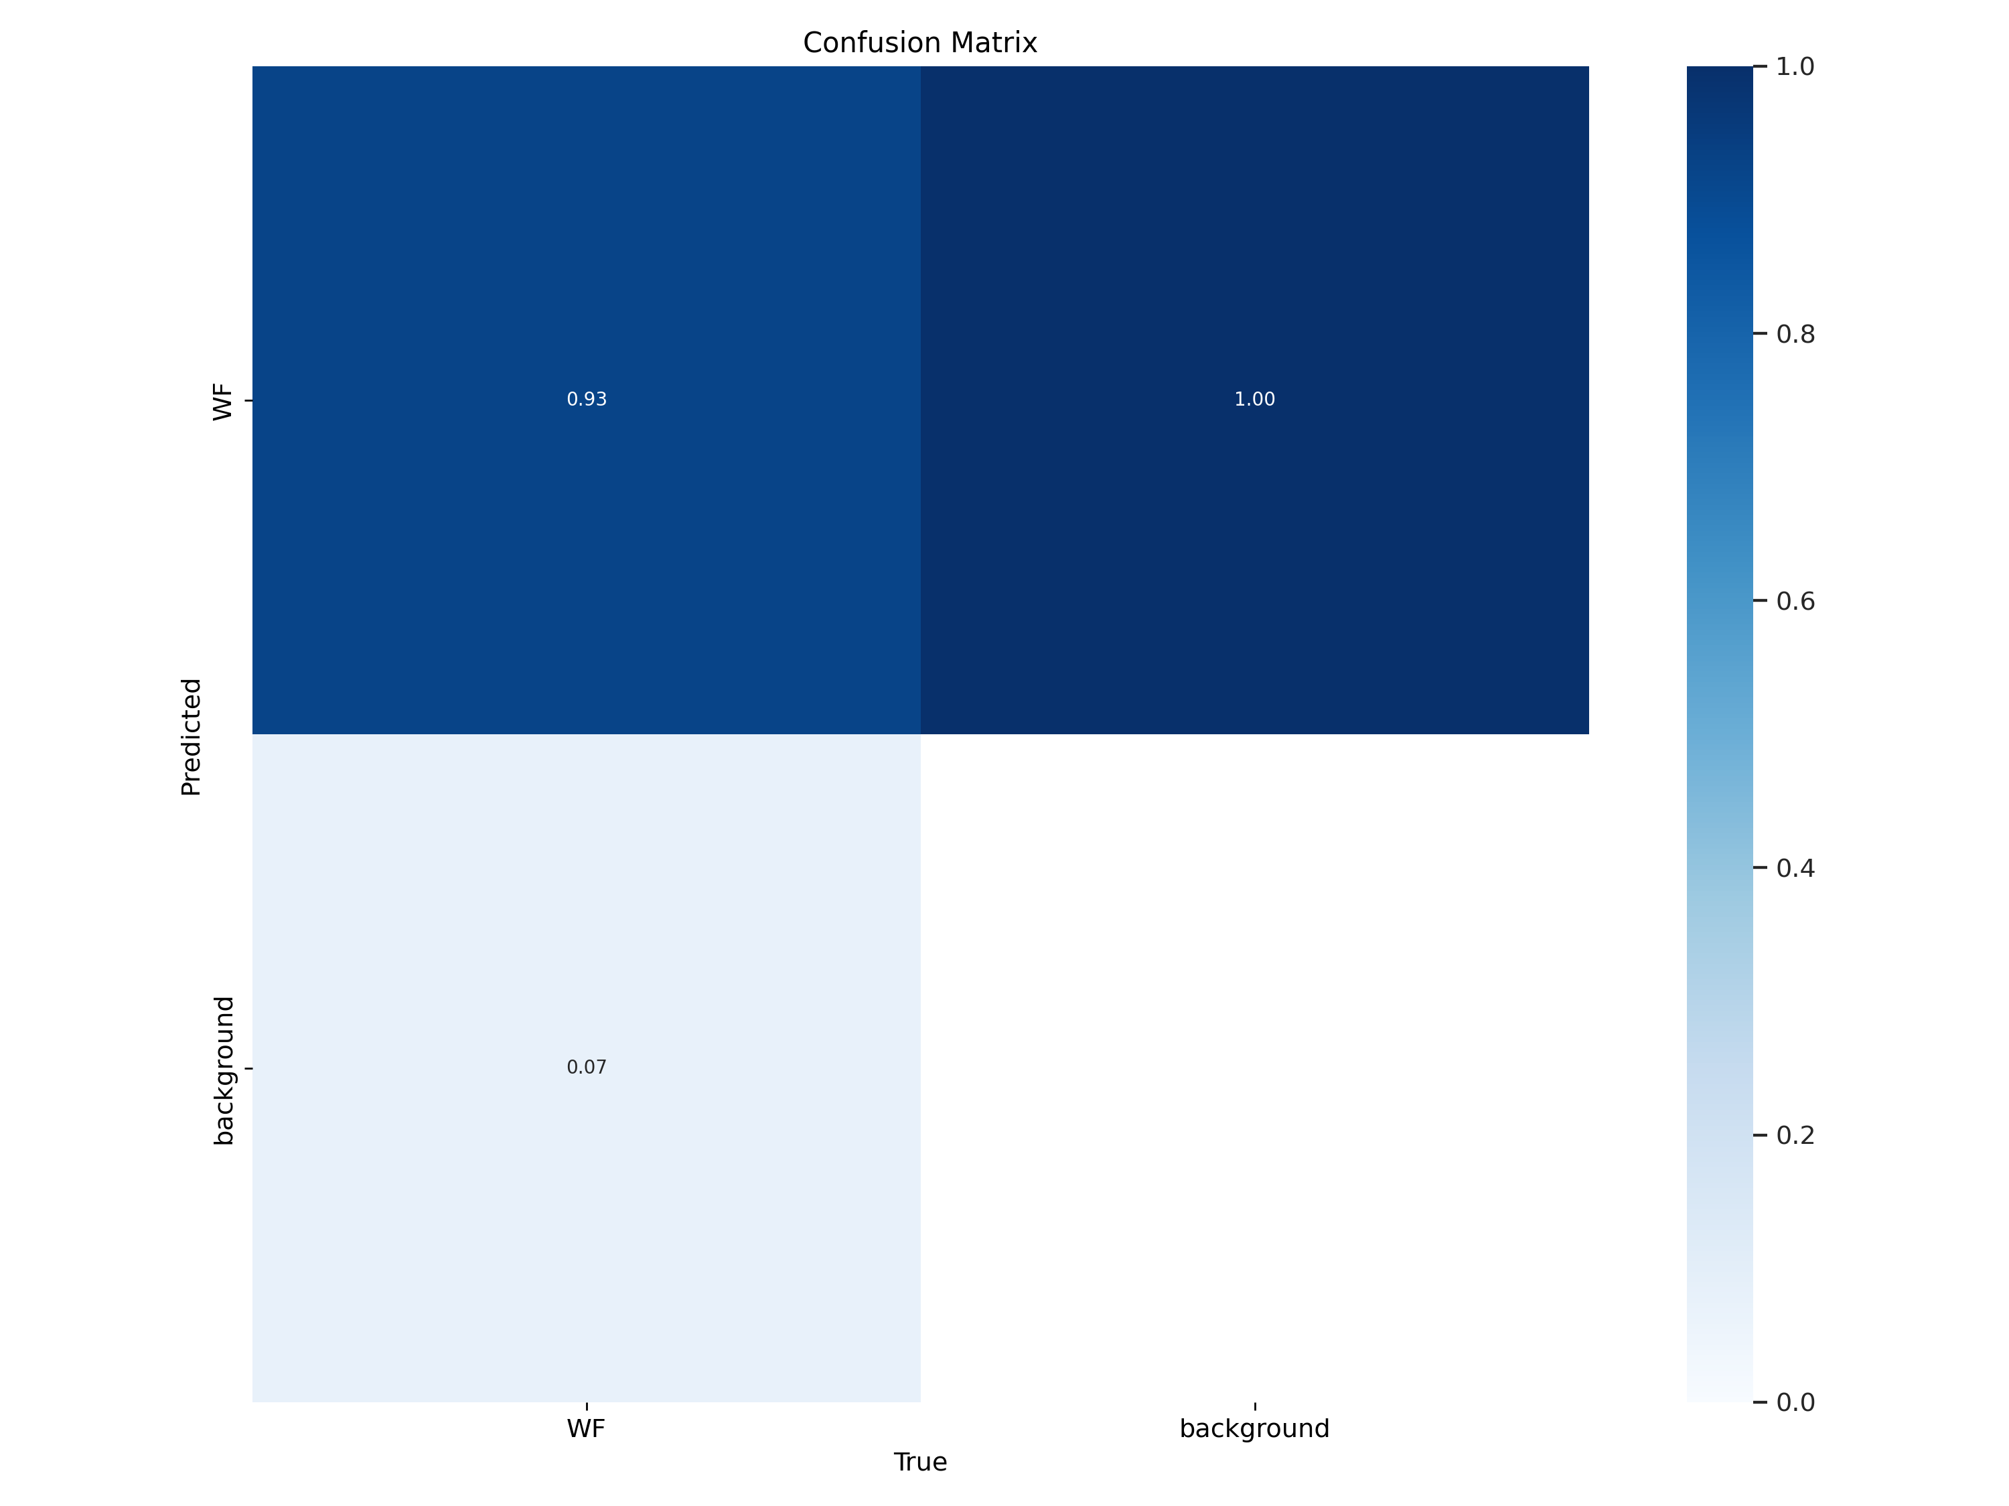


State-of-the-Art in Object Detection Metrics
Precision $= \frac{TP}{TP+FP}$
Recall $= \frac{TP}{TP+FN}$

Slide 25
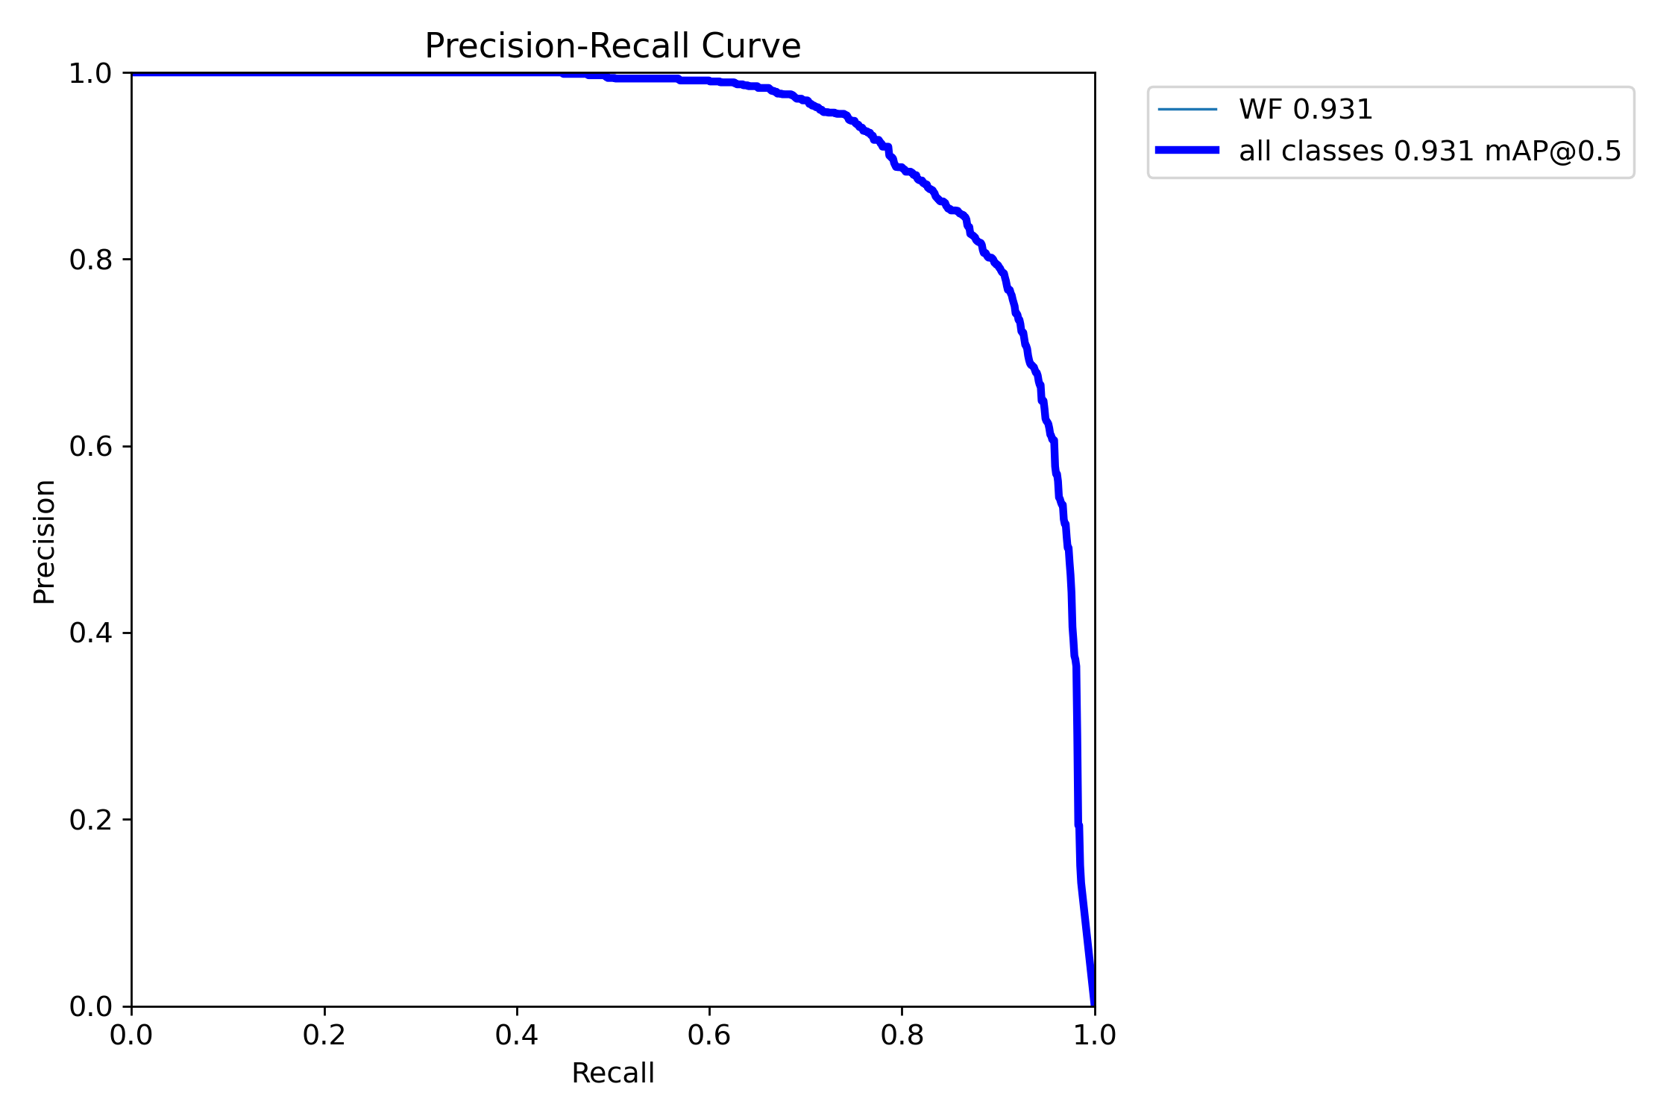
State-of-the-Art in Object Detection Metrics – mean Average Precision (mAP)

Slide 26
State-of-the-Art in Object Detection Challenges
Detecting small objects with limited pixel information.
Handling occlusion and overlapping objects robustly.
Domain adaptation: ensuring performance across diverse environments and conditions.
Zero-shot detection: recognizing unseen classes with no prior labeled examples.
Balancing efficiency vs. accuracy: lightweight vs. large, powerful models.
Real-time performance: maintaining high accuracy while ensuring fast inference speed, especially critical in applications like drone-based monitoring
Incorporating multi-modal data (e.g., combining vision and language) for richer understanding.

Slide 27
Active Learning

Slide 28
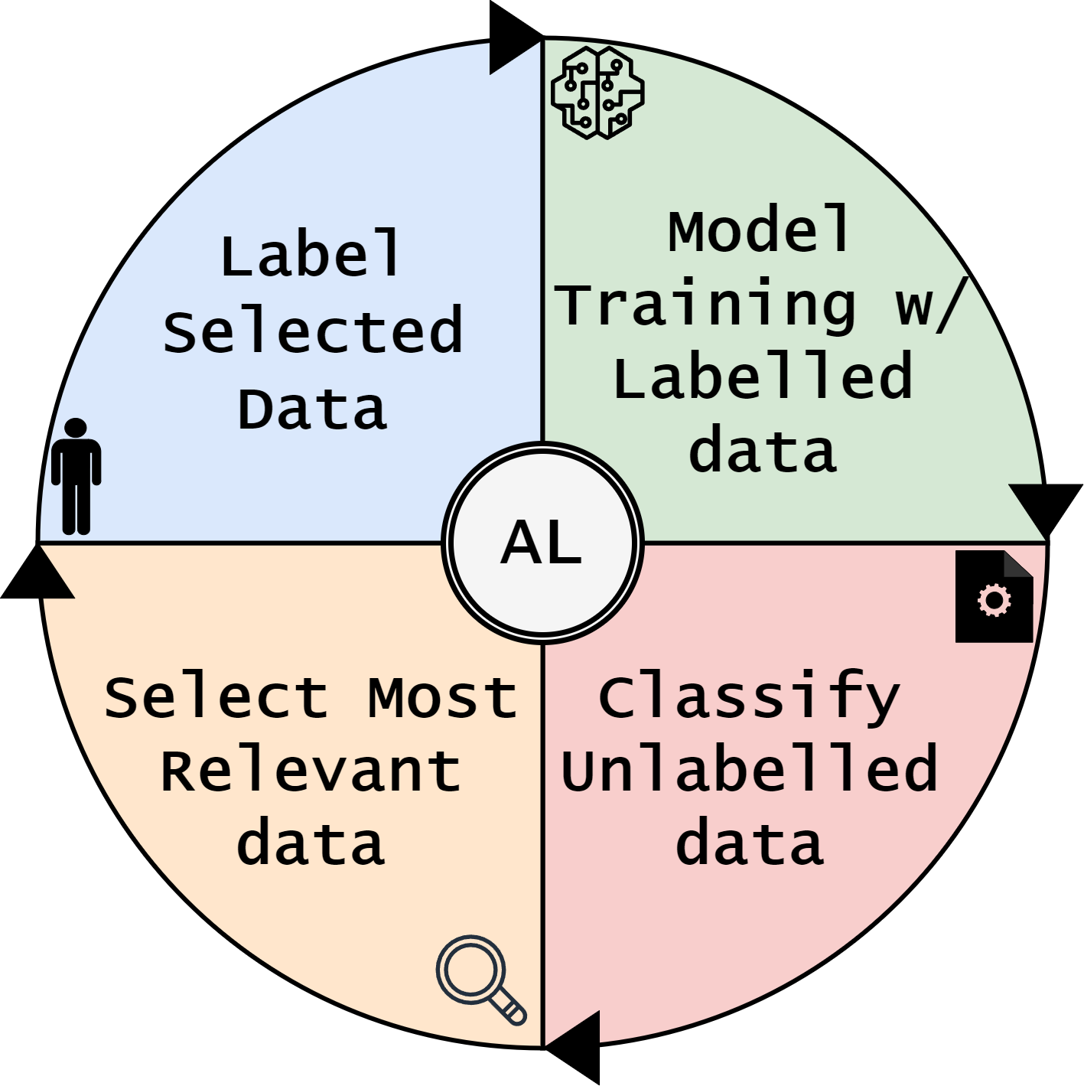
Active Learning
Select most relevant samples for training
Reduce Annotations Efforts
Improve Training Efficiency

Slide 29


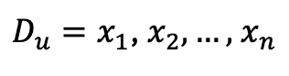
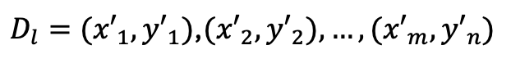
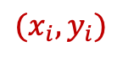

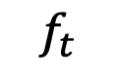
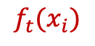
Active Learning
$$x_{i}$$
$${(x}_{i},y_{i})$$
Reject
Label
Oracle
Labelled Set
Unlabelled Set
$D_{u}=x_{1}$, $x_{2},…,$ $x_{n}$
$D_{l}={(x′}_{1},{y′}_{1})$,${(x′}_{2},{y′}_{2}),…,{(x′}_{m},{y′}_{n})$
$${f_{t}(x}_{i})$$
Uncertainty
$$x_{i}$$
Selects
Classifier
Train/update
$$f_{t}$$

Slide 30
Active Learning Expectation
mAP
Random Selected
Actively Selected
# samples

Slide 31

Hands on
URL: bit.ly/ibpria25tutorial

Slide 32
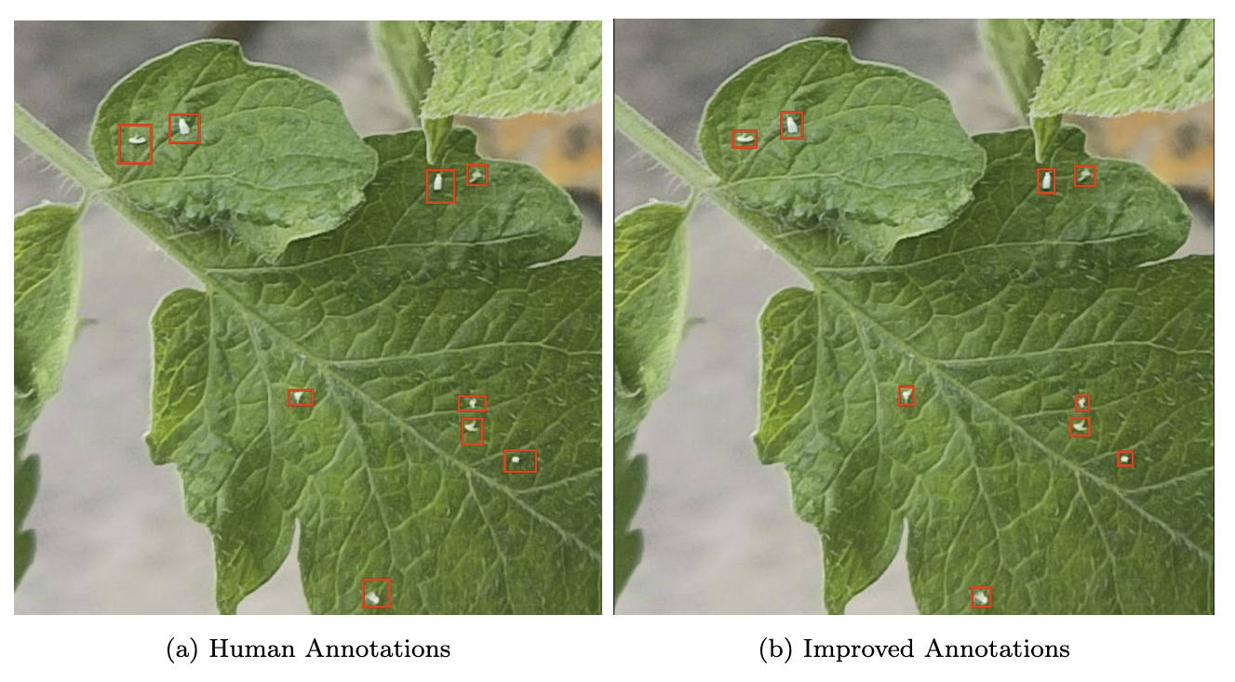
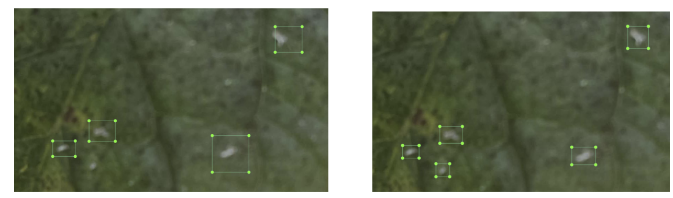
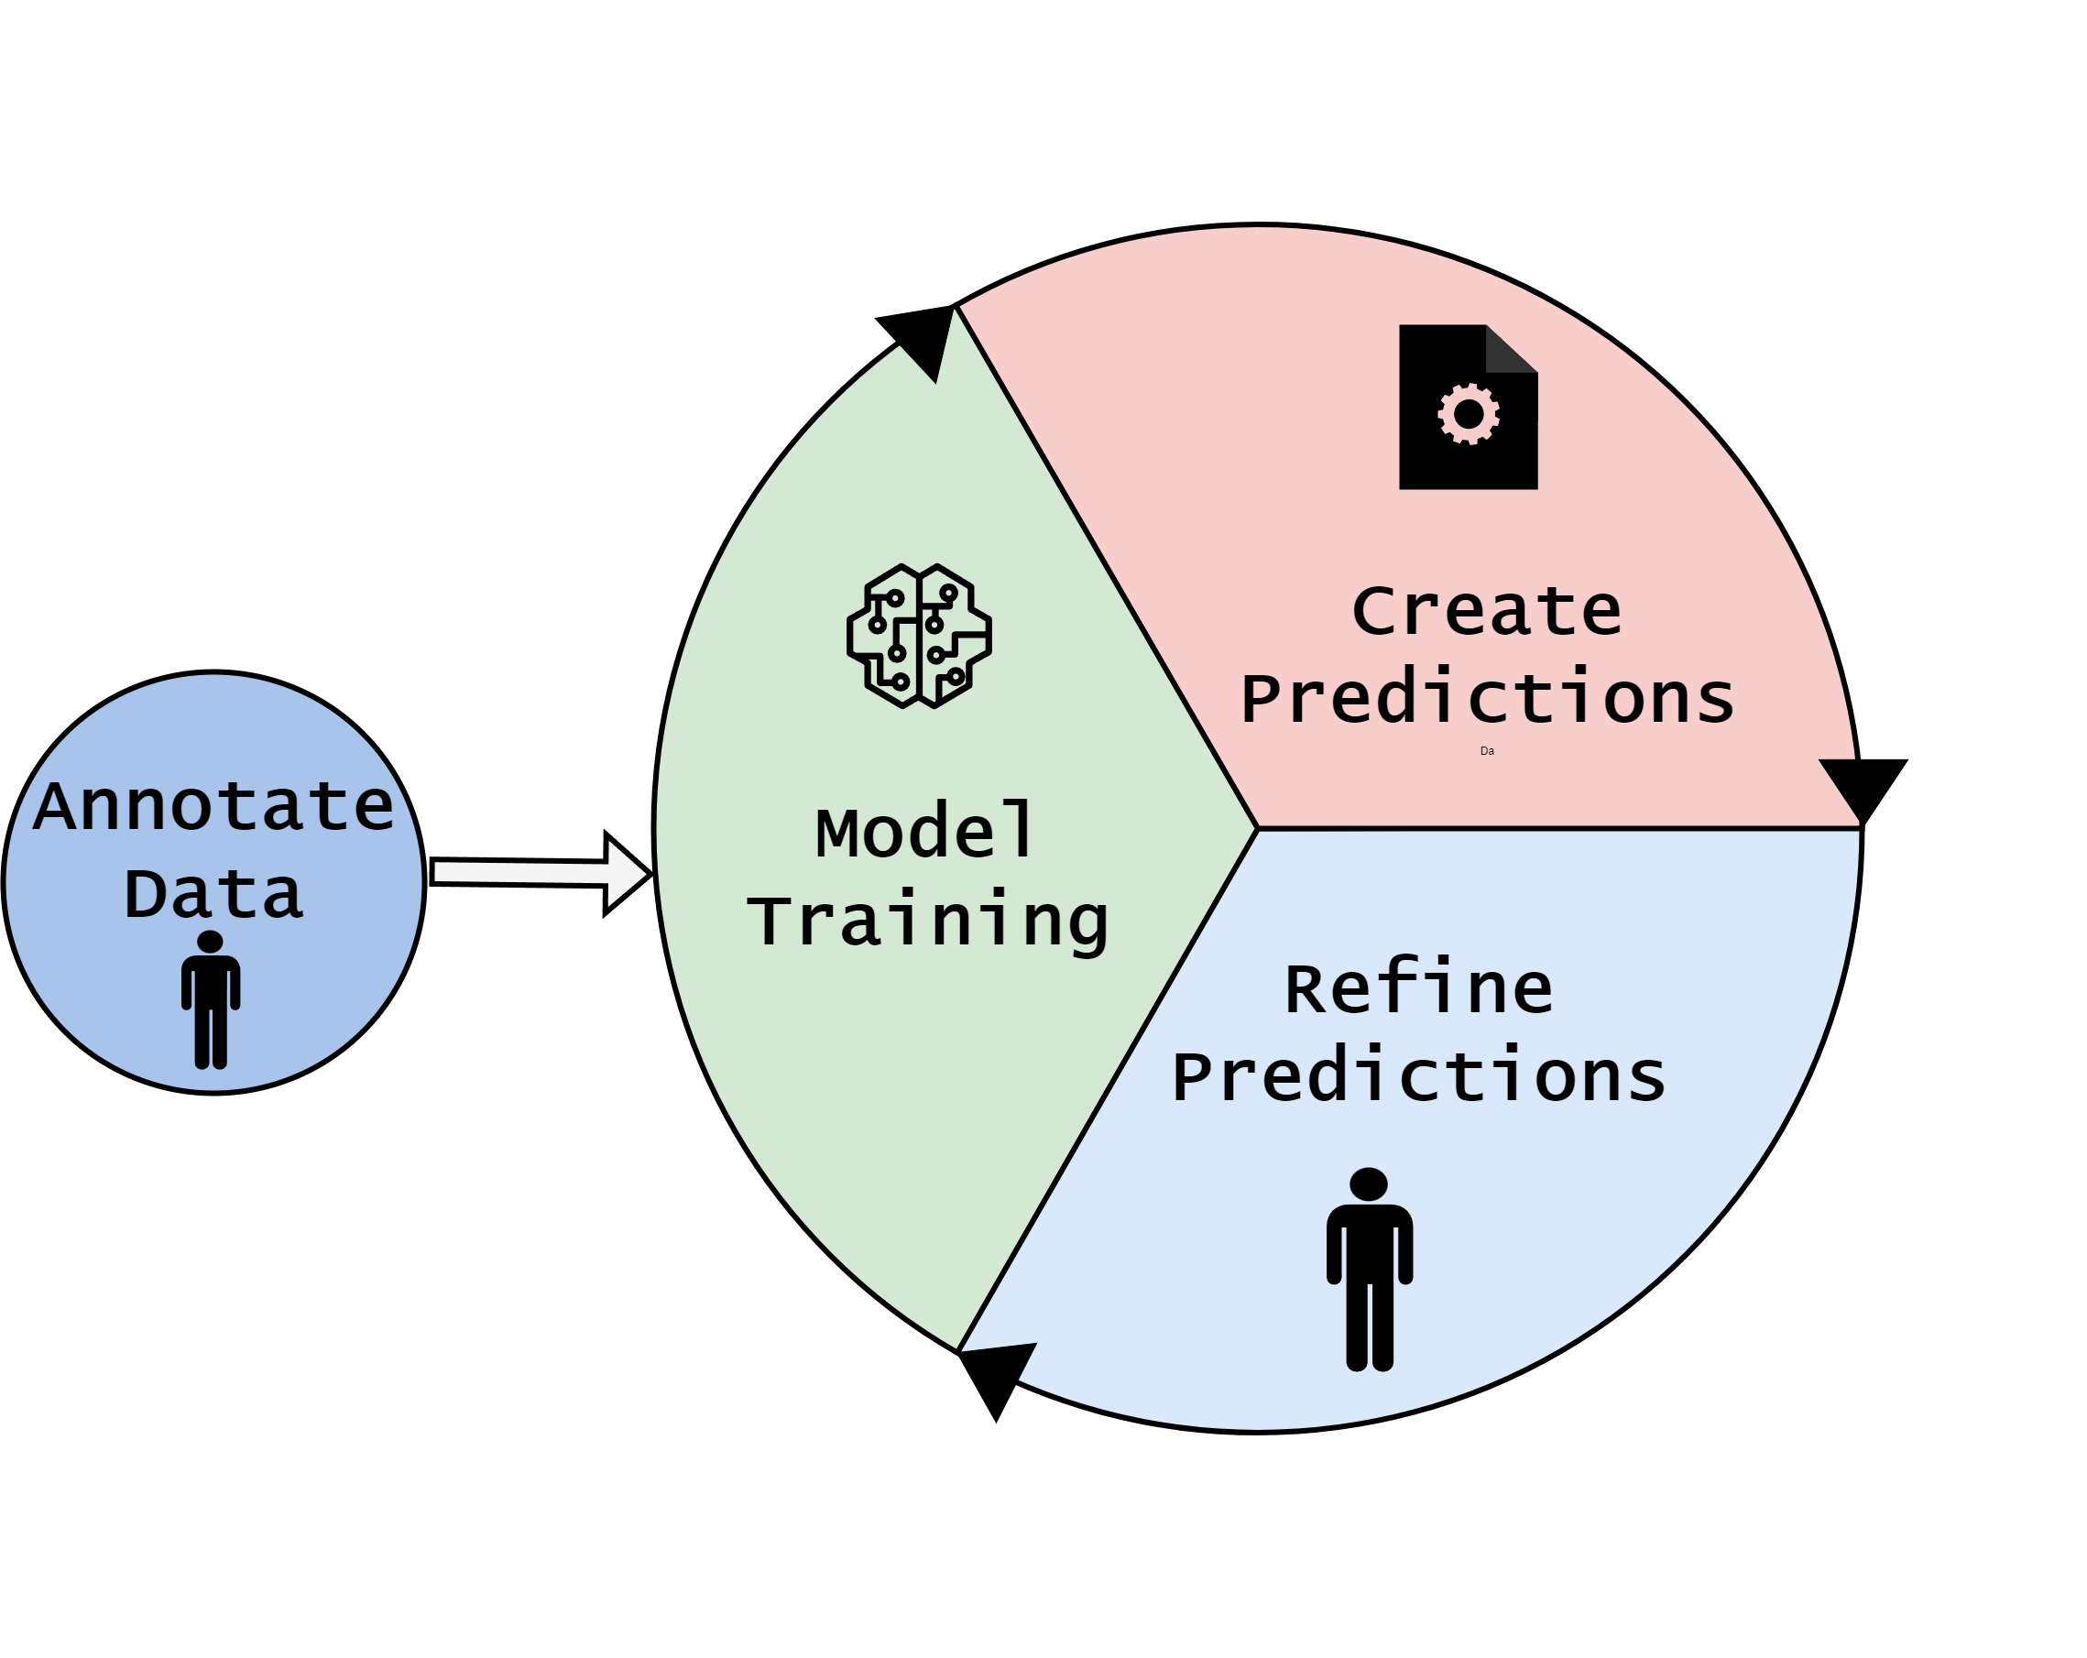
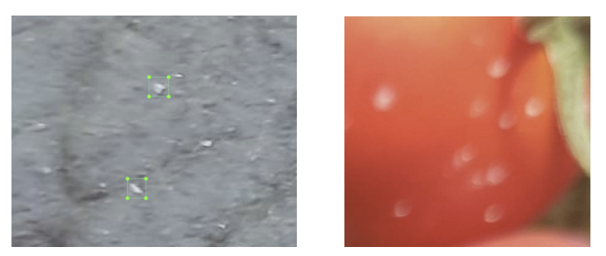
Data Quality
Key diffs
Impact
Ponte para mAP IoU - bbox

Slide 33
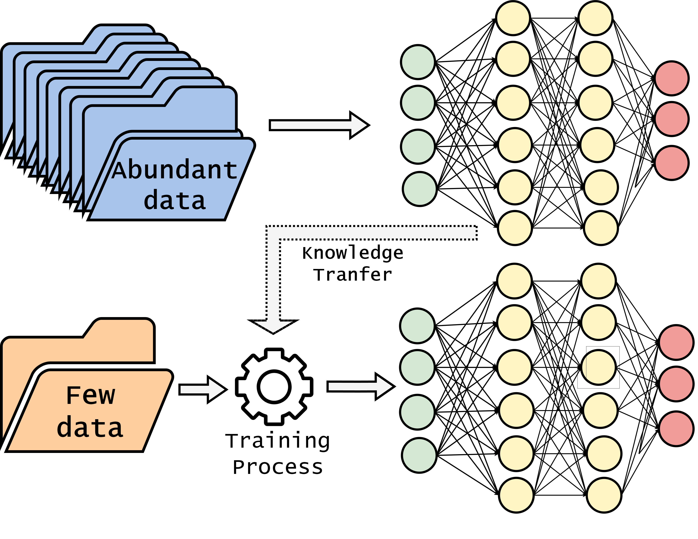
Transfer Learning

